Slide 1
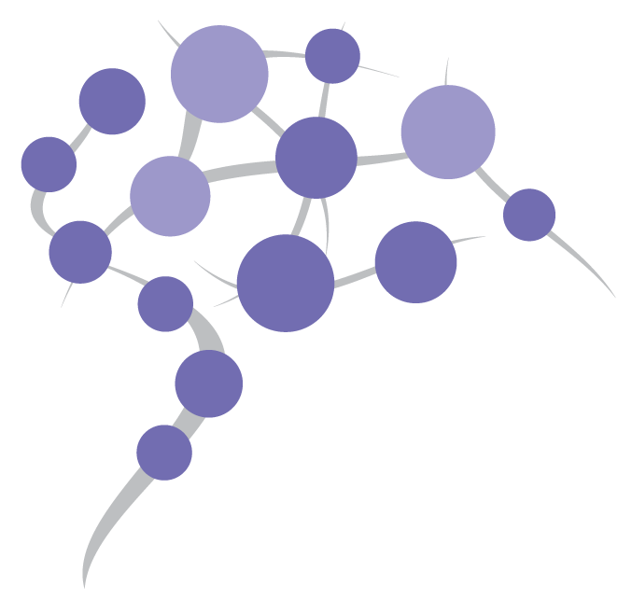


Workshop: Molecular pathways, pathway modelling and networks and network extension with drug related database information
Assistant professor Dr. Friederike Ehrhart
Department of Bioinformatics – BiGCaT
Maastricht University

Slide 2
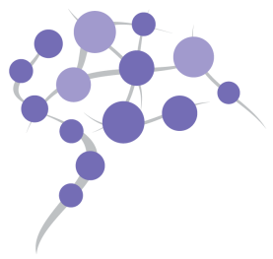
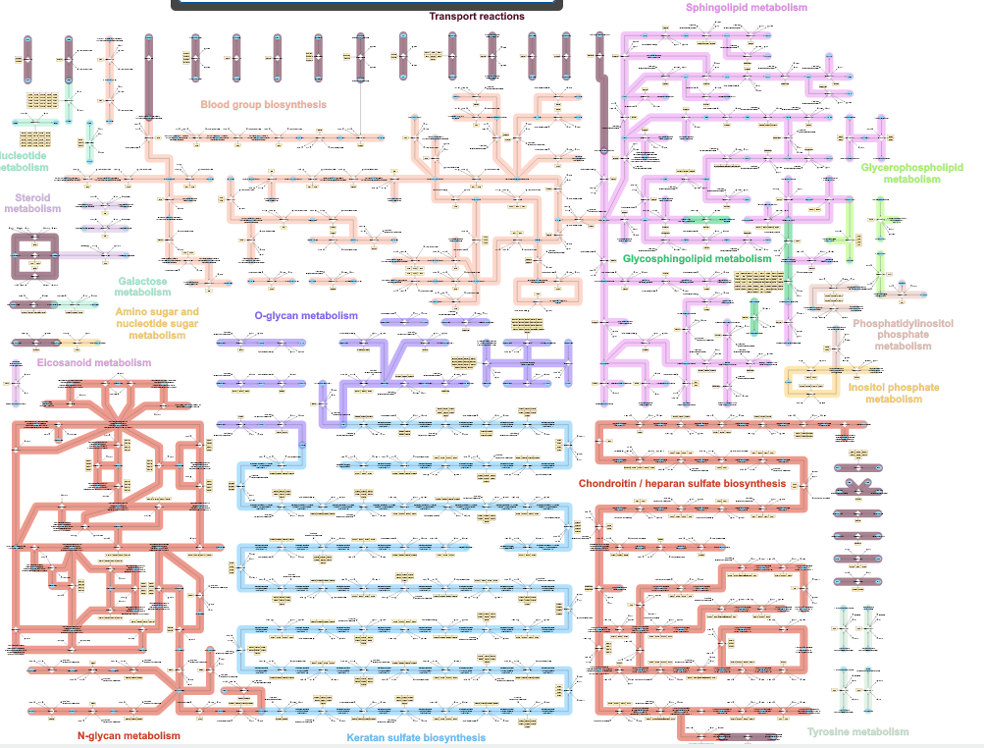
Why networks?
Biology is networks
https://metabolicatlas.org
Golgi apparatus

Slide 3
Biological networks

Slide 4

Knowledge graphs of molecular biology
Reference
provides_evidence
SNP
M2
has_a
regulates
Gene
Protein
catalyses
converts_to
associated_with
mRNA
M1
transcribes_to
translates_to
binds_to
Disease
inhibits
Drug

Slide 5

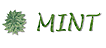



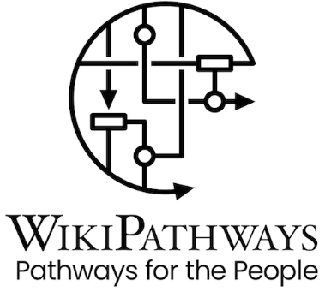

Data and knowledge sources
www.pathguide.org
Protein-Protein interactions: STRING, IntAct, MINT
Metabolic reactions: Rhea, BRENDA, HMDB
Protein-Compound interactions: DrugBank, Pathway Commons, BioDrugScreen, Ligand Expo
Genetic interactions: BIND, GeneMANIA, Interactome
All of them: Pathway databases: WikiPathways, KEGG, Reactome

Slide 6
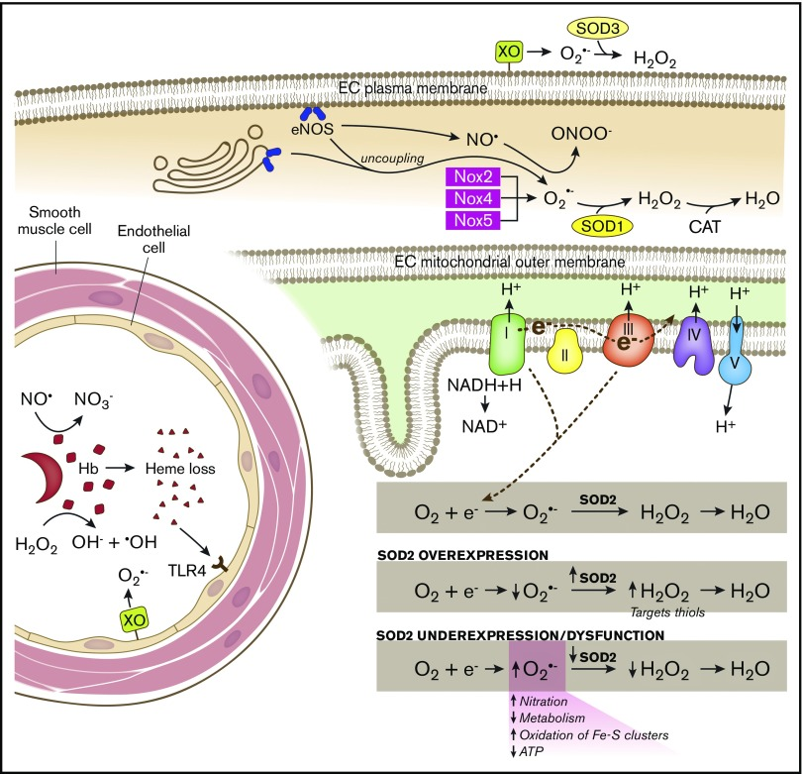
Why pathways?
Intuitive representation of complex information
è Over 1000 published each month
Proteins / genes / metabolites
Interactions / reactions
Subcellular location

Slide 7
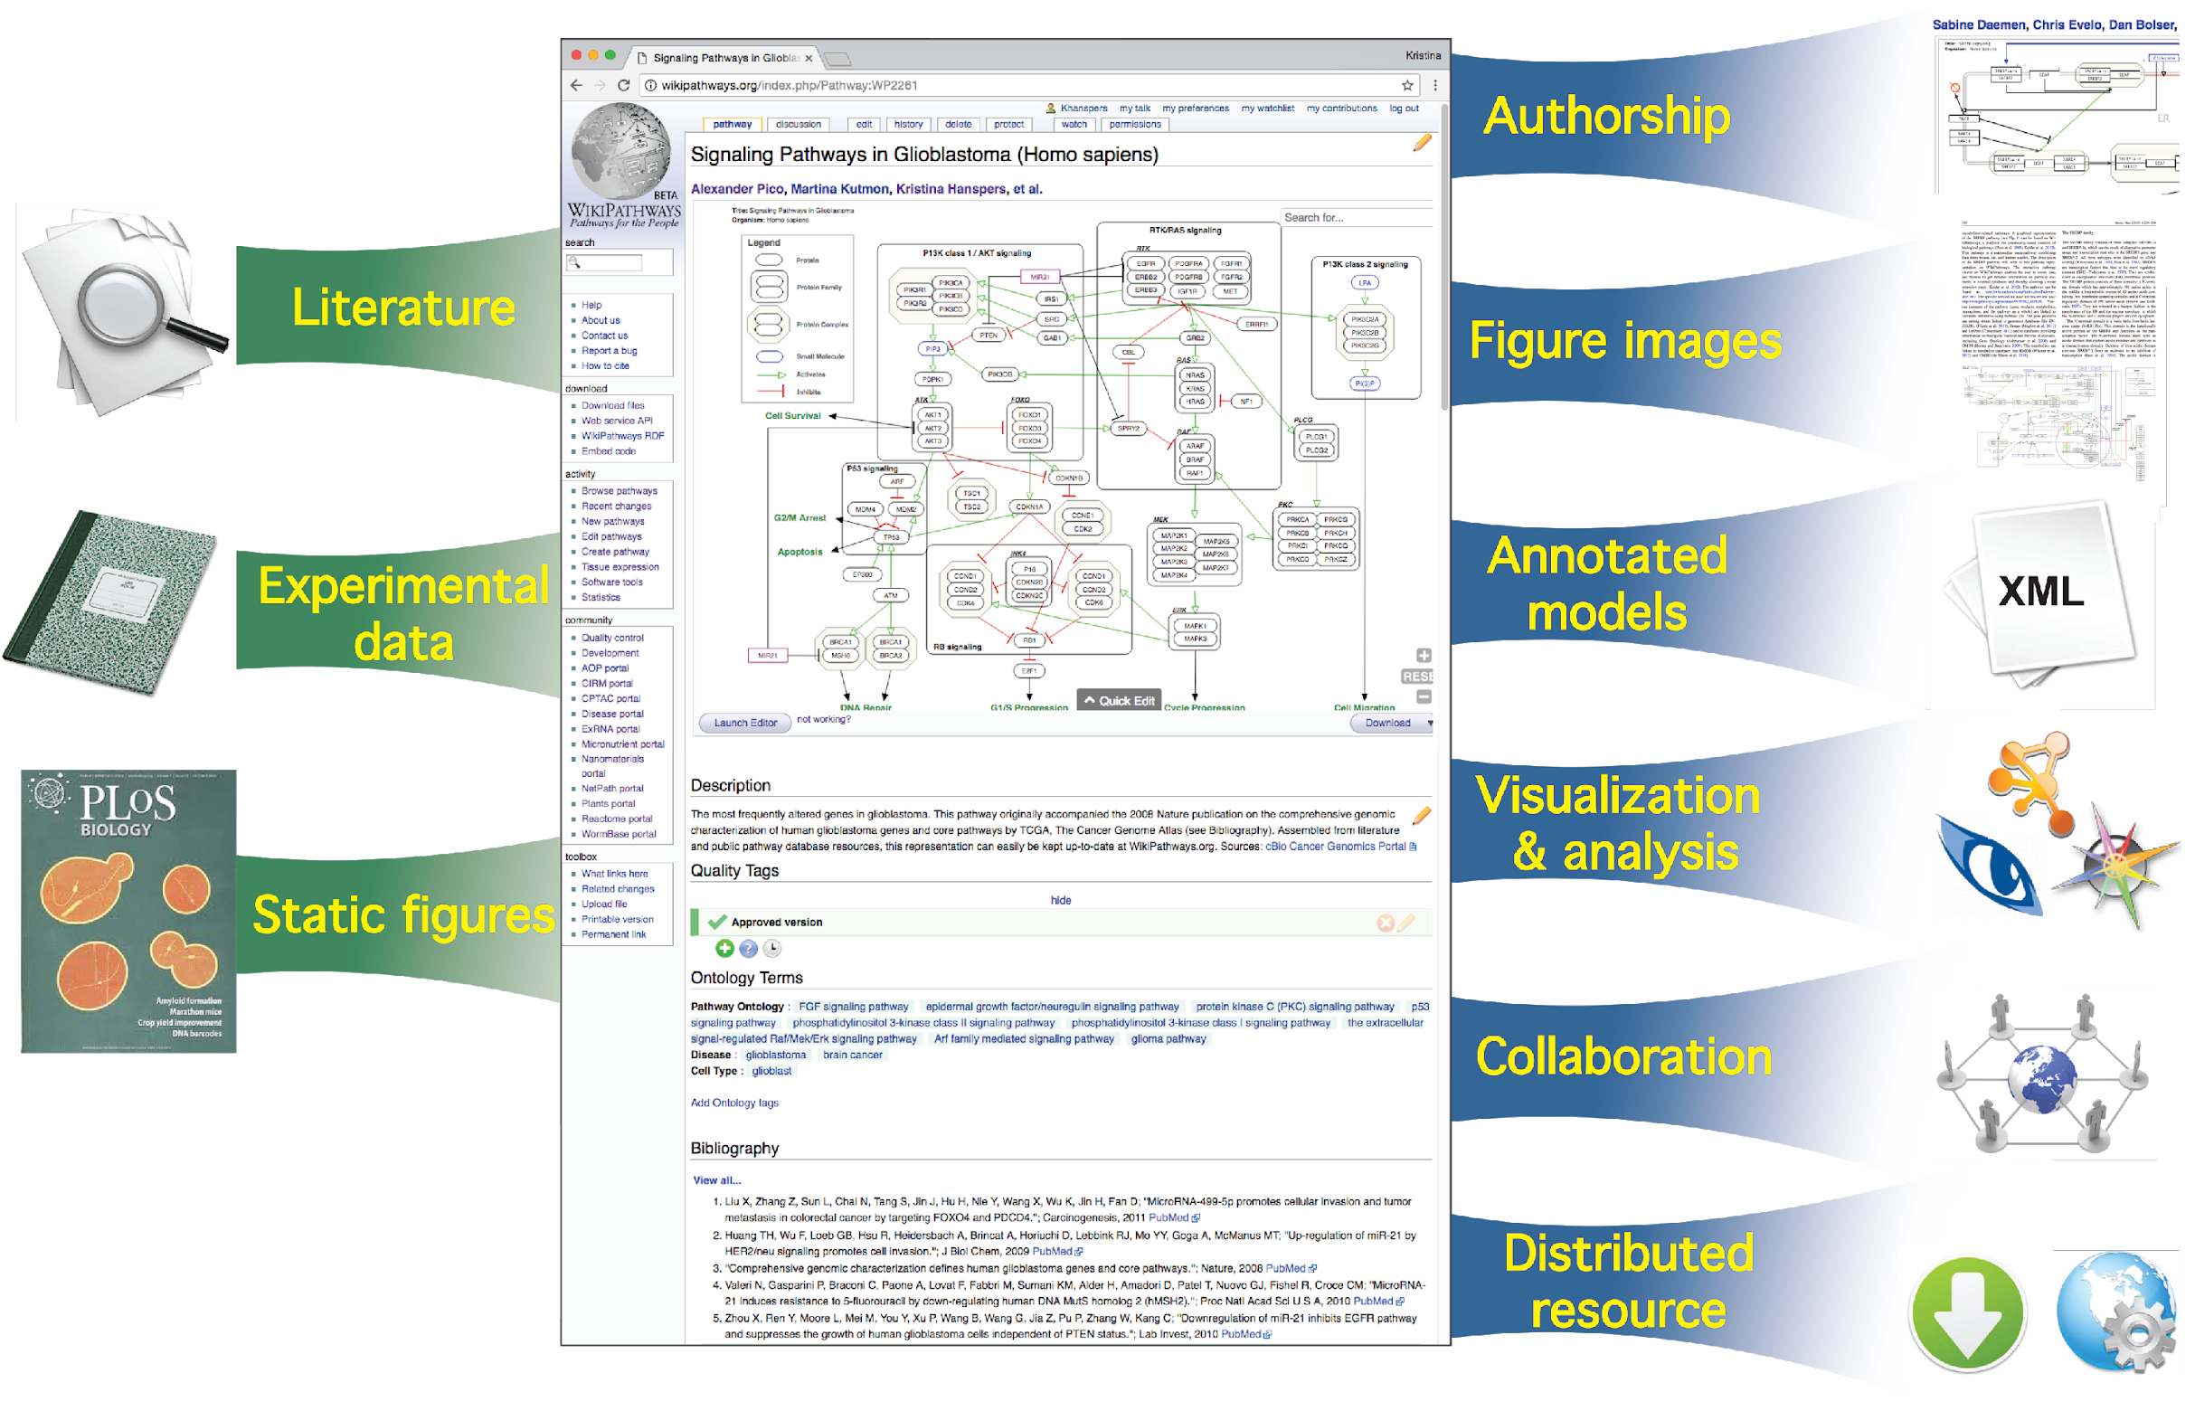
Why pathway models?

Slide 8

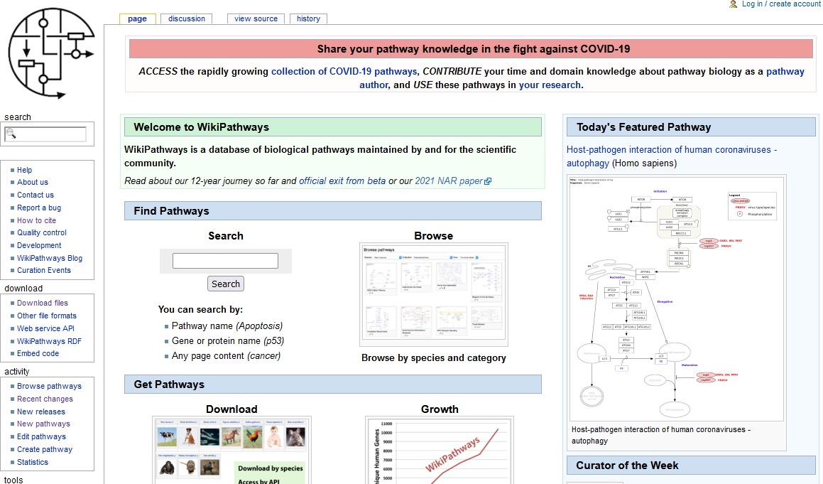
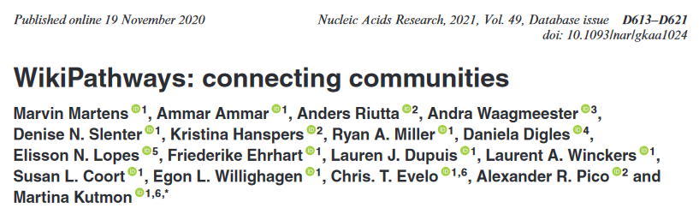
Making knowledge machine readable
Downloadable content
API
SPARQL endpoint
wikipathways.org

Slide 9
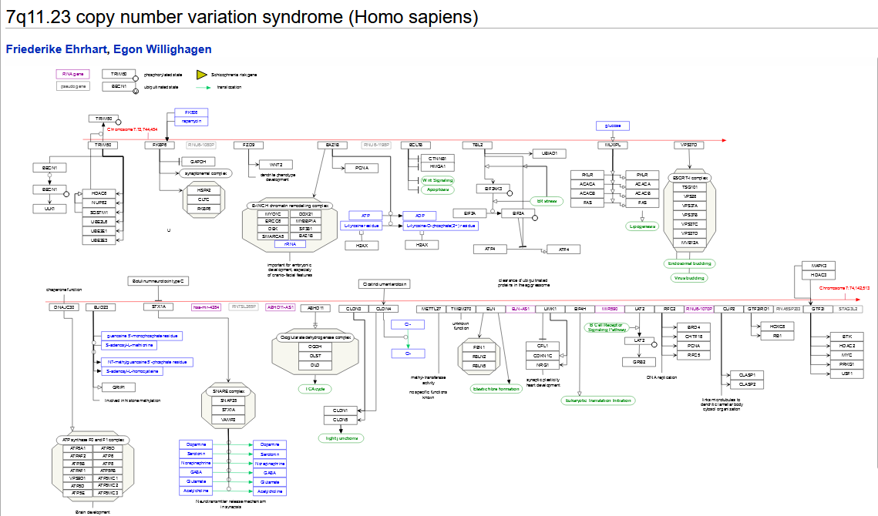
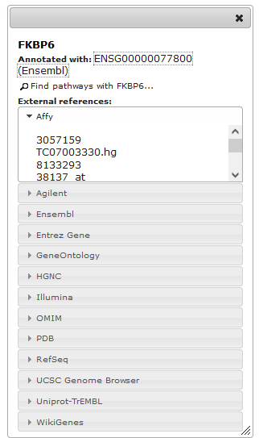
Literature references
Annotated, machine readable
interactions

Slide 10
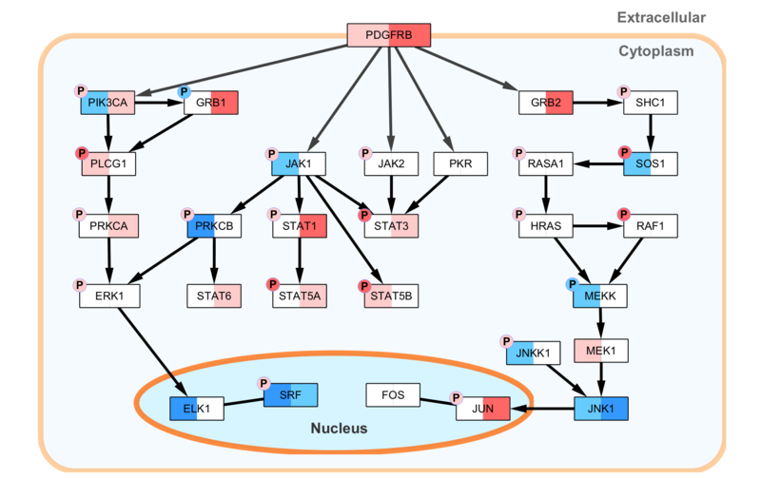
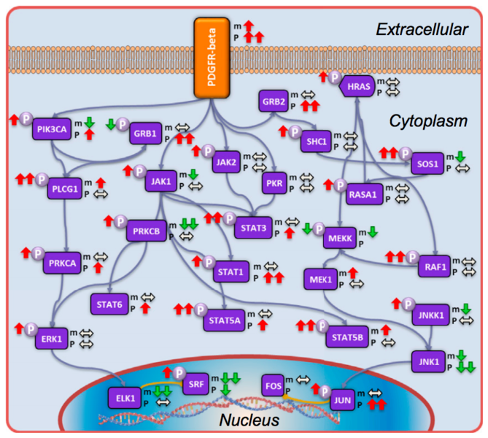
Data visualization on pathway models
PDGFR-beta pathway with transcriptomic/phosphoproteomic data
Zhang et al, Cell 2016
Static image
Zhang et al, Cell 2016

Slide 11
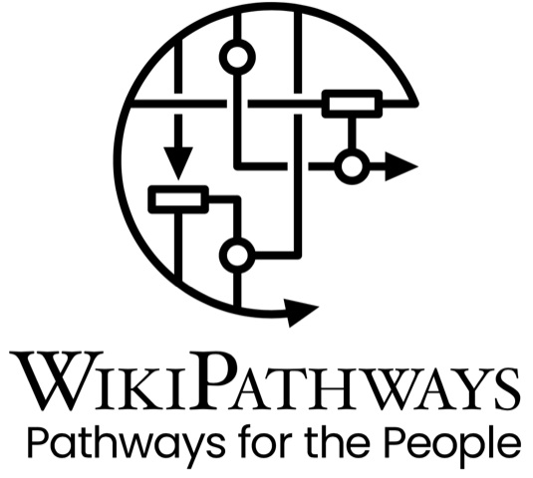

1
Walk through WikiPathways database
https://wikipathways.org

Slide 12

Creating and editing pathways
PathVisio 3.3.0
Java standalone desktop application
Draw and annotate biological pathways
Visualize your experimental data on pathways
Find pathways regulated in your dataset

Slide 13
1
Short demonstration of PathVisio editor

Slide 14
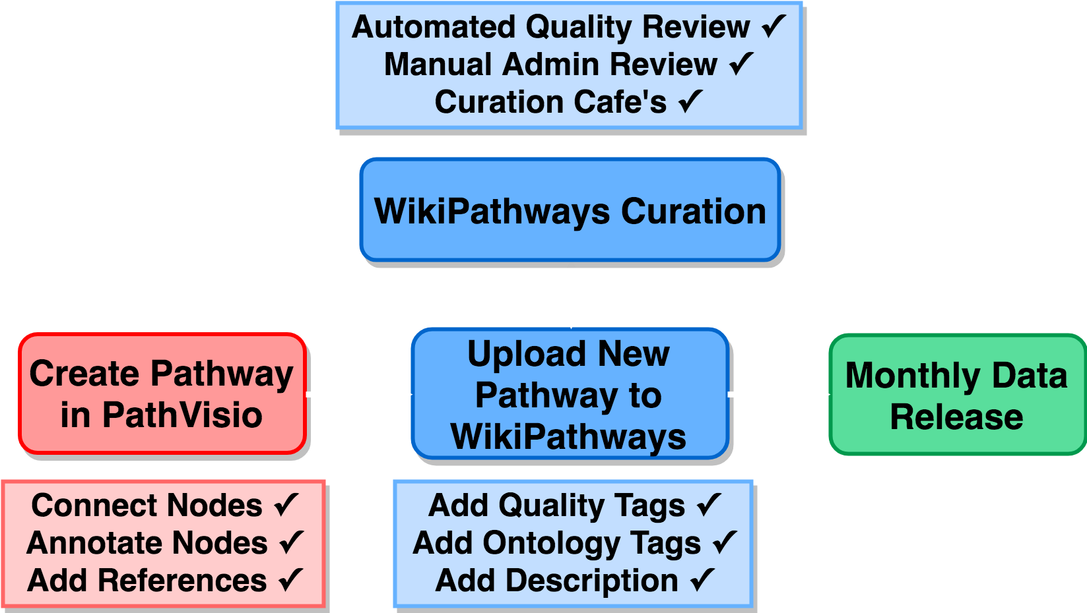
Life – cycle of a pathway model at WikiPathways

Slide 15
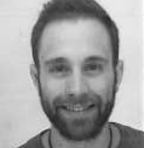
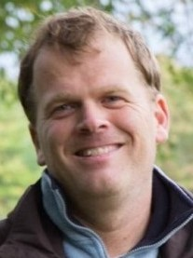
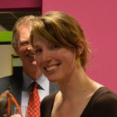

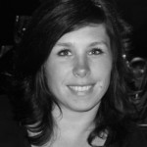


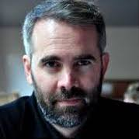

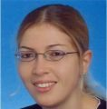
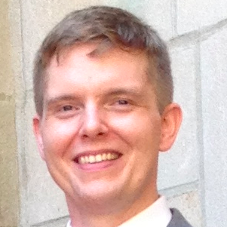
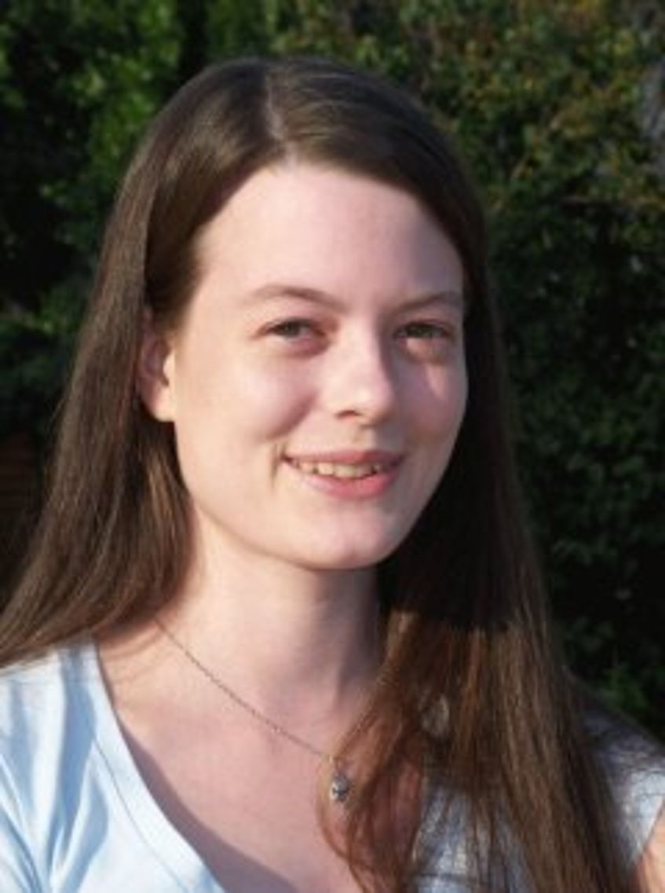

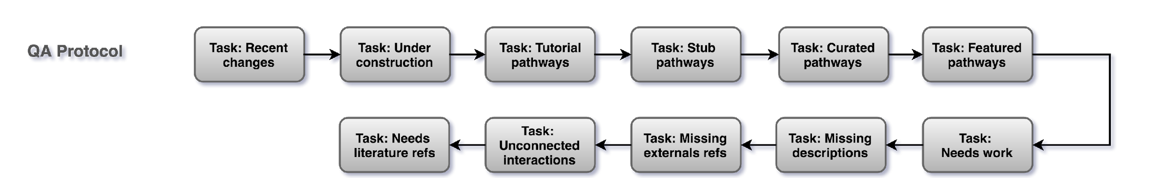
The curation quality assessment team
QA Team
https://wikipathways.github.io/academy/qaprotocol.html

Slide 16
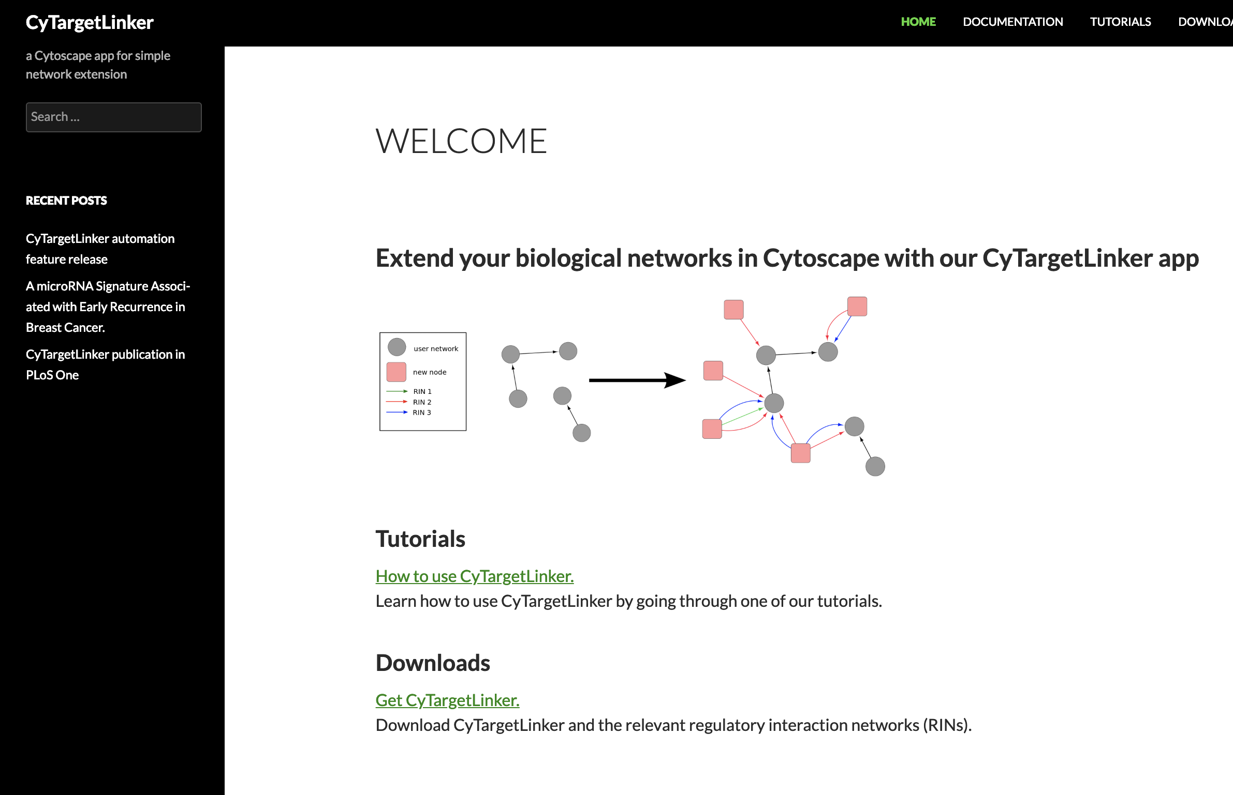
Network extension

Slide 17
Sources
Structural database (SCOP, CATH) – protein 3 D structures
Gene expression database (GEO, ArrayExpress) – gene expression data, first microarrays in the 1990ies – big expansion of omics data after 2000
Pathways database (KEGG, PathDB, WikiPathways)
Other, specialized databases
Species (Wormbase, HIV sequence, Flybase)
Bio imaging – microscopic images, MRI
Phenotyping (Decipher, HPO)
Gene-disease, variant-disease association (ClinVar, OMIM, DisGeNET)
miRNA-target (MirTarBase, mirBase)
Protein-protein interaction (IntAct, STRING)
Protein-chemical compound interaction (ChEMBL, DrugBank, CTD)
….
Any database that has molecular entity information and something else

Slide 18
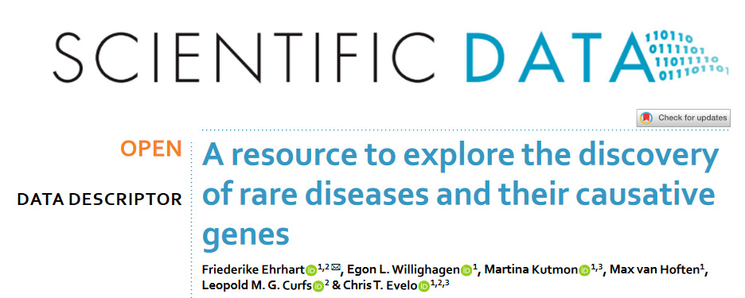
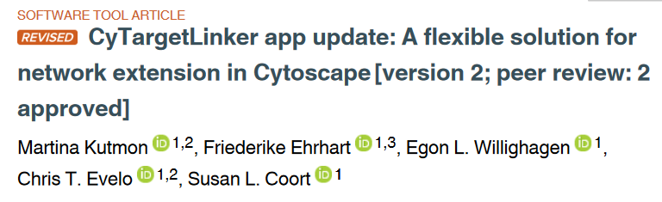
Integration of knowledge sources
https://cytargetlinker.github.io/
Currently available:
Drugs (DrugBank)
Transcription factors (ENCODE)
miRNA (MirTarBase)
Chemical compounds (ChEMBL)
Pathways (WikiPathways/Reactome)
Rare diseases (OMIM, Orphanet)

Slide 19
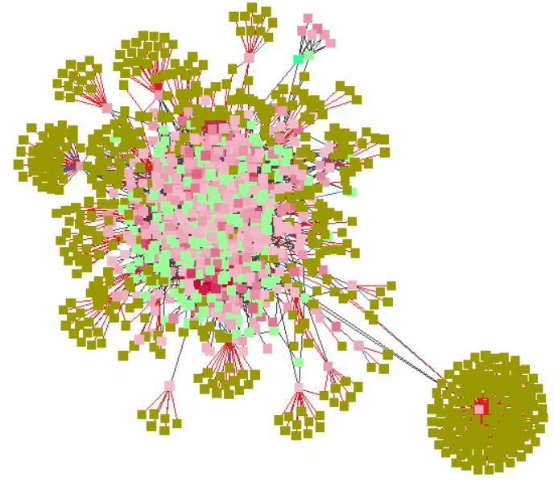

Integration of knowledge sources

Slide 20
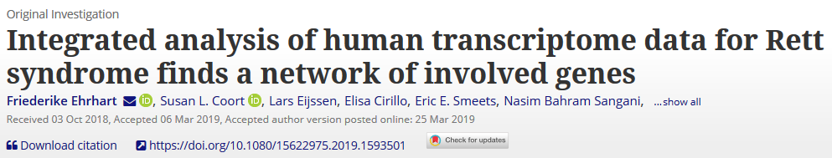
Identification of causal relationships
Possible explanation for neurite growth problems in neuronal cells of Rett syndrome patients:
MECP2
MEF2C
CAPG
CAPG
Capping of Forked Actin Filaments:
Responsible for cytoskeleton organization, neurite growth

Slide 21
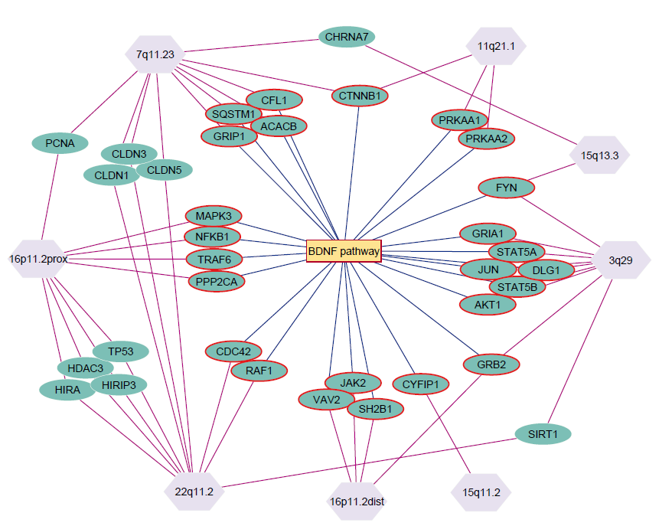
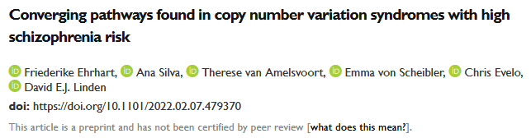
Identification of common mechanisms
What does a group of CNV syndromes have in common to explain high schizophrenia risk?
-> Their molecular pathways converge in the BDNF signaling pathway (and a few more)

Slide 22
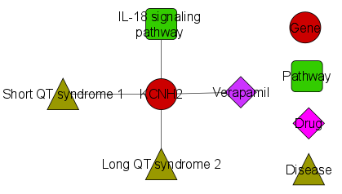
Identification of linked pathways, diseases or drug targets
Significantly differentially expressed
Network hub
Involved in IL-18 pathway
Linked to diseases
Drug known
KCNH2 is also part of the IL-18 pathway, which is a member of the IL-1 family of cytokines. It provides instructions for making potassium channels. It is also present in microglia and CNS.
IL-18 activates hematopoietic cell types mediating both Th1 and Th2 responses and is the primary inducer of interferon-I in these cells
Verapamil was used in neurological diseases such as, Alzheimer, Huntington and Parkinson's disease
Master thesis: Theodoros Zarotiadis

Slide 23
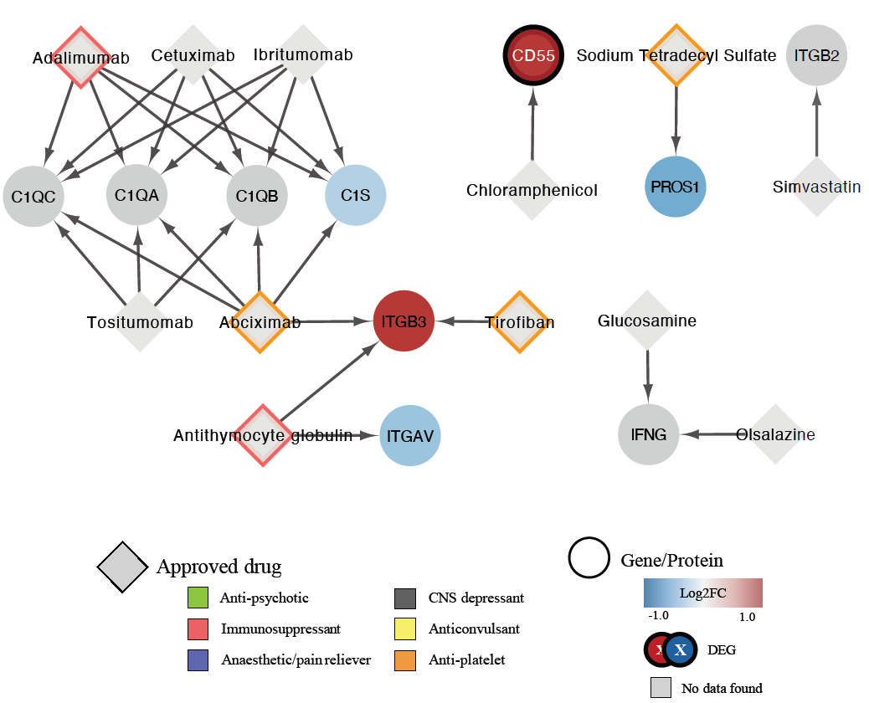
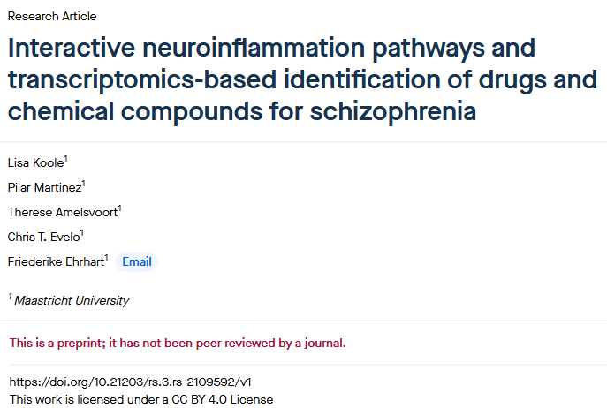
Identification of drug targets

Slide 24
1
Network extension Hands-on
Use Cytoscape to create 2 different networks, one based on a molecular pathway, another based on a list of differentially expressed genes
Extend the networks with 2 information on chemical compound/drugs and their targets

Slide 25


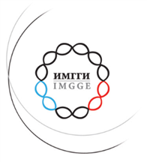



Strengthening regional stem cells based research for advancement of multi modal innovative
strategy for modelling
neurodevelopmental disorders
Thank you for your attention!
HORIZON-WIDERA-2021-ACCESS-02
Twinning Western Balkans

